Slide 1
Mobile Transport Layer

Slide 2
Traditional TCP
Mechanisms that influence the efficiency of TCP in a mobile environment
Congestion control
Slow start
Fast retransmit/fast recovery
Implications on mobility

Slide 3
Congestion control
TCP has been designed for fixed networks with fixed end-systems
Hardware and software are mature enough to ensure reliability of data.
The probable reason for a packet loss in a fixed network is a temporary overload at some point in the transmission path, i.e., a state of congestion at a node
The packet buffers of a router are filled and the router cannot forward the packets fast enough
The only thing a router can do in this situation is to drop packets
The sender notices the missing acknowledgement for the lost packet and assumes a packet loss due to congestion
Retransmitting the missing packet and continuing at full sending rate would now be unwise, as this might only increase the congestion.

Slide 4
Slow start
The behavior TCP shows after the detection of congestion is called slow start
The sender always calculates a congestion window for a receiver.
The start size of the congestion window is one segment (TCP packet).
This scheme doubles the congestion window every time the acknowledgements come back, which takes one round trip time (RTT) like 1, 2, 4, 8 etc.
This is called the exponential growth of the congestion window in the slow start mechanism.
The exponential growth stops at the congestion threshold.
As soon as the congestion window reaches the congestion threshold, further increase of the transmission rate is only linear by adding 1 to the congestion window each time the acknowledgements come back
Linear increase continues until a time-out at the sender occurs due to a missing acknowledgement, or until the sender detects a gap in transmitted data
  the sender sets the congestion threshold to half of the current congestion window
  The congestion window itself is set to one segment

Slide 5
Fast retransmit/fast recovery
Fast Retransmit
a receiver sends acknowledgements only if it receives any packets from the sender.
Receiving acknowledgements from a receiver also shows that the receiver continuously receives something from the sender.
The gap in the packet stream is not due to severe congestion, but a simple packet loss due to a transmission error.
The sender can now retransmit the missing packet(s) before the timer expires.
This behavior is called fast retransmit.

Slide 6
Fast retransmit/fast recovery
Fast Recovery
The receipt of acknowledgements shows that there is no congestion to justify a slow start.
The sender can continue with the current congestion window.
The sender performs a fast recovery from the packet loss
This mechanism can improve the efficiency of TCP dramatically..

Slide 7
Implications on mobility
TCP concludes a congestion situation from a missing acknowledgement
  typically wrong in wireless networks, here we often have packet loss due to transmission errors
  mobility itself can cause packet loss, if e.g. a mobile node roams from one access point (e.g. foreign agent in Mobile IP) to another while there are still packets in transit to the wrong access point and forwarding is not possible
The performance of an unchanged TCP degrades severely
  TCP cannot be changed fundamentally due to the large base of installation in the fixed network,
TCP for mobility has to remain compatible
  the basic TCP mechanisms keep the whole Internet together

Slide 8
CLASSICAL TCP IMPROVEMENTS
Indirect TCP (I-TCP)
Snooping TCP
Mobile TCP
Fast retransmit/fast recovery
Transmission/time-out freezing
Selective retransmission
Transaction-oriented TCP

Slide 9
Indirect TCP (I-TCP)
I-TCP segments a TCP connection into a
  fixed part - Standard TCP is used
  wireless part - optimized TCP protocol
splitting of the TCP connection at, e.g., the foreign agent into 2 TCP connections, no real end-to-end sconnection any longer
hosts in the fixed part of the net do not notice the characteristics of the wireless part

Slide 10
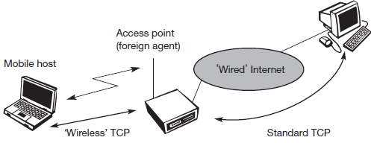
Indirect TCP (I-TCP)
Socket and state migration after handover of a mobile host

Slide 11
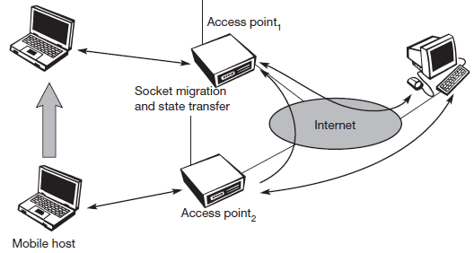
Indirect TCP (I-TCP)
Socket and state migration after handover of a mobile host

Slide 12
Indirect TCP (I-TCP)
Advantages
no changes in the fixed network necessary, no changes for the hosts (TCP protocol) necessary, all current optimizations to TCP still work
transmission errors on the wireless link do not propagate into the fixed network
simple to control, mobile TCP is used only for one hop between, e.g., a foreign agent and mobile host
therefore, a very fast retransmission of packets is possible, the short delay on the mobile hop is known
Disadvantages
loss of end-to-end semantics, an acknowledgement to a sender does now not any longer mean that a receiver really got a packet, foreign agents might crash
higher latency possible due to buffering of data within the foreign agent and forwarding to a new FA

Slide 13
Snooping TCP
the foreign agent buffers all packets with destination mobile host and additionally ‘snoops’ the packet flow in both directions to recognize acknowledgements
buffering enable the FA to perform a local retransmission in case of packet loss on the wireless link
Transparent extension of TCP within the foreign agent
buffering of packets sent to the mobile host
lost packets on the wireless link (both directions!) will be retransmitted immediately by the mobile host or foreign agent, respectively (so called “local” retransmission)
the foreign agent therefore “snoops” the packet flow and recognizes acknowledgements in both directions, it also filters ACKs changes of TCP only within the foreign agent

Slide 14
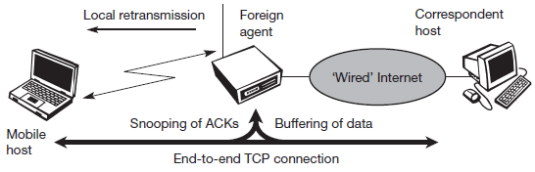
Snooping TCP

Slide 15
Snooping TCP
Data transfer to the mobile host
  FA buffers data until it receives ACK of the MH, FA detects packet loss via duplicated ACKs or time-out
  fast retransmission possible, transparent for the fixed network
Data transfer from the mobile host
  FA detects packet loss on the wireless link via sequence numbers,
FA answers directly with a NACK to the MH
  MH can now retransmit data with only a very short delay
Integration of the MAC layer
  MAC layer often has similar mechanisms to those of TCP
  thus, the MAC layer can already detect duplicated packets due to retransmissions and discard them
Problems
  snooping TCP does not isolate the wireless link as good as I-TCP
  snooping might be useless depending on encryption schemes

Slide 16
Snooping TCP
Advantages
The end-to-end TCP semantic is preserved
The correspondent host does not need to be changed; most of the enhancements are in the foreign agent
It does not need a handover of state as soon as the mobile host moves to another foreign agent.
It does not matter if the next foreign agent uses the enhancement or not.
Disadvantages
Snooping TCP does not isolate the behavior of the wireless link as well as ITCP
Using negative acknowledgements between the foreign agent and the mobile host assumes additional mechanisms on the mobile host.
All efforts for snooping and buffering data may be useless if certain encryption schemes are applied end-to-end between the correspondent host and mobile host .

Slide 17
Mobile TCP
Special handling of lengthy and/or frequent disconnections
M-TCP splits as I-TCP does
  unmodified TCP fixed network to supervisory host (SH)
  optimized TCP SH to MH
Supervisory host
  no caching, no retransmission
  monitors all packets, if disconnection detected
set sender window size to 0
sender automatically goes into persistent mode
  old or new SH reopen the window
Advantages
  maintains semantics, supports disconnection, no buffer forwarding
Disadvantages
  loss on wireless link propagated into fixed network
  adapted TCP on wireless link

Slide 18
Fast retransmit / fast recovery
Change of foreign agent often results in packet loss
  TCP reacts with slow-start although there is no congestion
Forced fast retransmit
  as soon as the mobile host has registered with a new foreign agent, the MH sends duplicated acknowledgements on purpose
  this forces the fast retransmit mode at the communication partners
  additionally, the TCP on the MH is forced to continue sending with the actual window size and not to go into slow-start after registration
Advantage
  simple changes result in significant higher performance
Disadvantage
  further mix of IP and TCP, no transparent approach .

Slide 19
Transmission / time-out freezing
Mobile hosts can be disconnected for a longer time
  no packet exchange possible, e.g., in a tunnel, disconnection due to overloaded cells or mux. with higher priority traffic
  TCP disconnects after time-out completely
TCP freezing
  MAC layer is often able to detect interruption in advance
  MAC can inform TCP layer of upcoming loss of connection
  TCP stops sending, but does now not assume a congested link
  MAC layer signals again if reconnected
Advantage
  scheme is independent of data
Disadvantage
  TCP on mobile host has to be changed, mechanism depends on MAC layer

Slide 20
Selective retransmission
TCP acknowledgements are often cumulative
  ACK n acknowledges correct & in-sequence receipt of packets up to n.
  if single packets are missing quite often a whole packet sequence beginning at the gap has to be retransmitted (go-back-n), thus wasting bandwidth
Selective retransmission as one solution
  RFC2018 allows for acknowledgements of single packets, not only acknowledgements of in-sequence packet streams without gaps
  sender can now retransmit only the missing packets
Advantage
  much higher efficiency
Disadvantage
  more complex software in a receiver, more buffer needed at the receiver

Slide 21
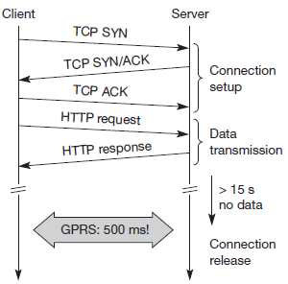
Transaction-oriented TCP
TCP phases
  setup, data transmission, connection release
  using 3-way-handshake needs 3 packets for setup and release, respectively
  thus, even short messages need a minimum of 7 packets!
Transaction oriented TCP
  RFC1644, T-TCP, describes a TCP version to avoid this overhead
  connection setup, data transfer and connection release can be combined
  thus, only 2 or 3 packets are needed
Advantage : efficiency
Disadvantage
  requires changed TCP
  mobility not longer transparent

Slide 22
Selective retransmission
Approach | Mechanism | Advantages | Disadvantages
Indirect TCP | Splits TCP connection into two connections | Isolation of wireless link, simple | Loss of TCP semantics, higher latency at handover, security problems
Snooping TCP | Snoops data and acknowledgements,local retransmission | Transparent for end-to-end connection, MAC integration possible | Insufficient isolation of wireless link, security problems
M-TCP | Splits TCP connection, chokes sender via window size | Maintains end-to-end semantics, andles long term and frequent disconnections | Bad isolation of wireless link, processing overhead due to bandwidth management, security problems
Fast retransmit / fast recovery | Avoids slow-start after roaming | Simple and efficient | Mixed layers, not transparent
Transmission / time-out freezing | Freezes TCP state at disconnection, resumes after reconnection | Independent of content, works for longer interruptions | Changes in TCP required, MAC dependent
Selective retransmission | Retransmits only lost data | Very efficient | Slightly more complex receiver software, more buffer space needed
Transaction- oriented TCP | Combines connection setup/release and data transmission | Efficient for certain applications | Changes in TCP required, not transparent, security problems

Slide 23
TCP over 2.5/3G wireless networks
Transmission control protocol (TCP) by IETF is one of the most widely used transport layer protocols in Internet.
Much development and deployment activity has centered around GPRS, UMTS and IMT-2000, also referred to 2.5G/3G wireless networks.
However, TCP has not been designed bearing in mind wireless networks.
Especially, flow control features can perform less than optimally over wireless interfaces.
A number of TCP optimization techniques have been studied to enhance the TCP performance for various wireless environments.

Slide 24
TCP Improvements I
TCP over 2.5/3G wireless networks
  Fine tuning today’s TCP
  Learn to live with
    Data rates: 64 kbit/s up, 115-384 kbit/s down; asymmetry: 3-6, but also up to 1000 (broadcast systems), periodic allocation/release of channels
    High latency, high jitter, packet loss
  Suggestions
    Large (initial) sending windows, large maximum transfer unit, selective acknowledgement, explicit congestion notification, time stamp, no header compression
  Already in use
    i-mode running over FOMA
    WAP 2.0 (“TCP with wireless profile”)

Slide 25
TCP Improvements II
Performance enhancing proxies (PEP, RFC 3135)
  Transport layer
    Local retransmissions and acknowledgements
  Additionally on the application layer
    Content filtering, compression, picture downscaling
    E.g., Internet/WAP gateways
    Web service gateways?
  Big problem: breaks end-to-end semantics
    Disables use of IP security
    Choose between PEP and security!
More open issues
  RFC 3150 (slow links)
    Recommends header compression, no timestamp
  RFC 3155 (links with errors)
    States that explicit congestion notification cannot be used
  In contrast to 2.5G/3G recommendations!
Mobile system
wireless
PEP
Internet
Comm. partner

